Slide 1
Training a Linear Perceptron and activation functions

Slide 2
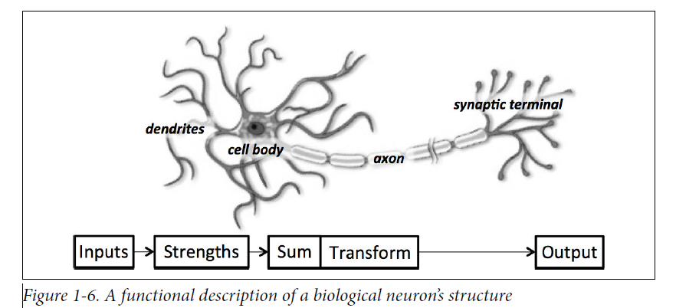
Review- The Biological neuron

Slide 3
Artificial neuron
The functional understanding of the neurons in our brain is translated into an artificial model that can be represented on our computer , by Warren S. McC ulloch and Walter H. Pitts.
Just as in biological neurons, our artificial neuron takes in some number of inputs, x1, x2, . . . , xn, each of which is multiplied by a specific weight, w1,w2, . . . ,wn.
These weighted inputs are, summed together to produce the logit (output of a neuron without applying activation function)of the neuron

Slide 4


Artificial neuron
the logit also includes a bias, which is a constant. The logit is then passed through a function f to produce the output y = f (z) .
This output can be transmitted to other neurons

Slide 5
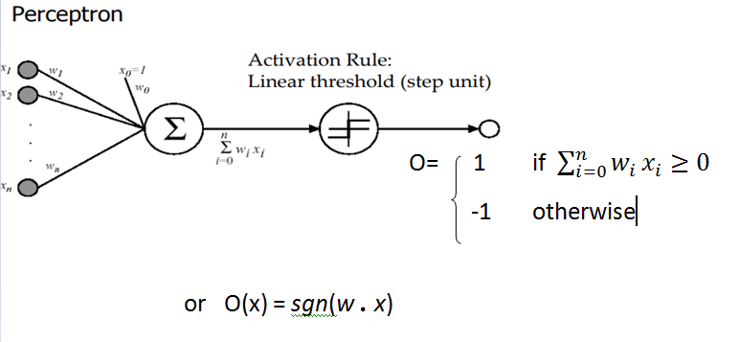
Linear Perceptron

Slide 6
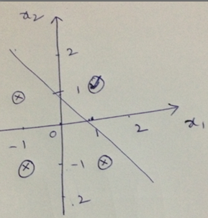
Designing Logical And gate using Perceptron
Learning Boolean And gate
x1 | x2 | y
F | F | F
T | F | F
F | T | F
T | T | T
x1 | x2 | y
-1 | -1 | -1
1 | -1 | -1
-1 | 1 | -1
1 | 1 | 1

Slide 7
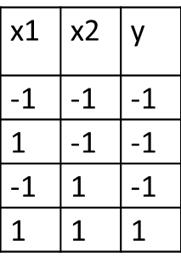
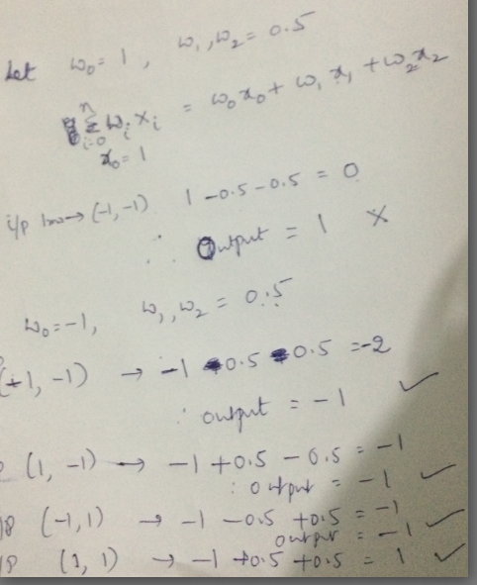
Training Linear Perceptron-identifying weights

Slide 8
Assignment 1
Design boolean OR gate

Slide 9
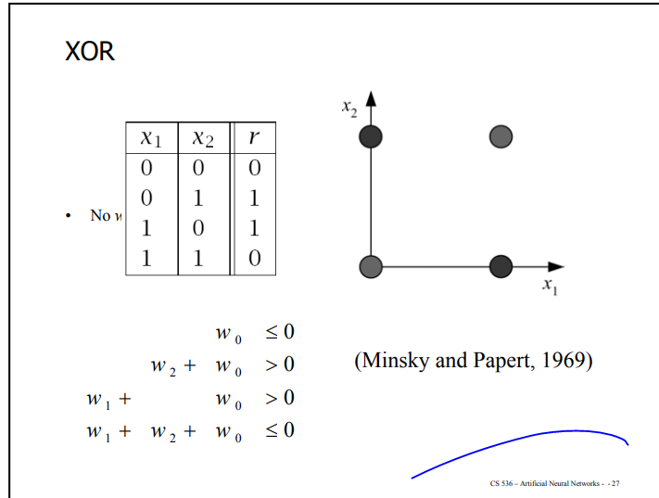
Try solving XOR

Slide 10
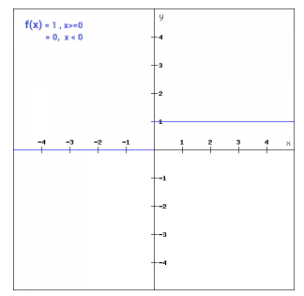
Popular types of activation functions
Binary Step Function
f(x) = 1 if x>=0
= 0 if x<0
if the input to the activation function is greater than a threshold, then the neuron is activated, else it is deactivated, i.e. its output is not considered for the next layer.

Slide 11
drawback
The binary step function can be used as an activation function while creating a binary classifier.
This function will not be useful when there are multiple classes in the target variable.
That is one of the limitations of binary step function.

Slide 12
Sigmoid, Tanh and ReLU -nonlinear activation functions
sigmoid , which uses the function:
f(z) = 1/(1+e^(-z))
when the logit is very small, the output of a logistic function is very close to 0.
When the logit is very large, the output of the logistic function is close to 1.
In-between these two extremes, the function assumes an S-shape

Slide 13
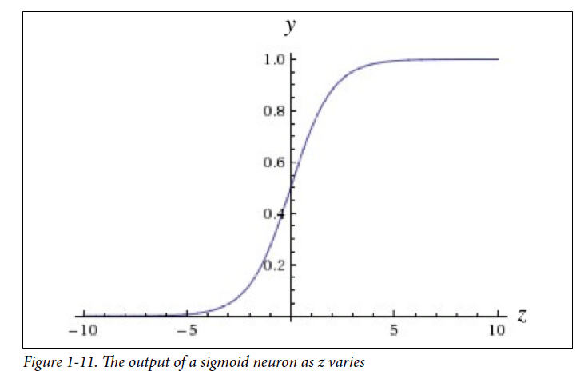
sigmoid

Slide 14
Tanh activation function
Tanh functions use a similar kind of S-shaped nonlinearity, but instead of ranging from 0 to 1, the output of tanh function ranges from −1 to 1.
f( z) = tanh( z) = 1 — e^(-2z) / 1 + e^(-2z)
When S-shaped nonlinearities are used, the tanh activation function is often preferred over the sigmoid because it is zero-centered

Slide 15
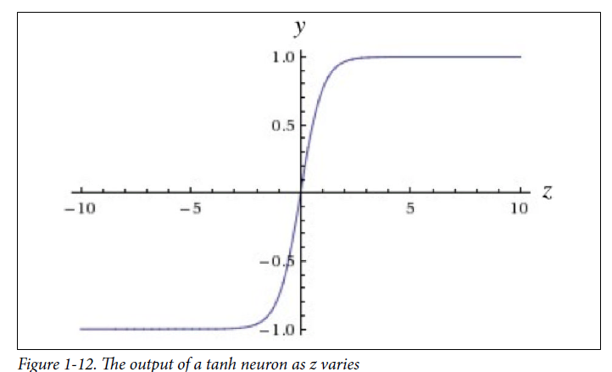
Tanh

Slide 16
RELU activation function
Rectified linear unit (ReLU)
uses the function f( z) = max (0, z) , resulting in a characteristic hockey-stick-shaped response.
The ReLU function is used in most of the deep learning models these days.

Slide 17
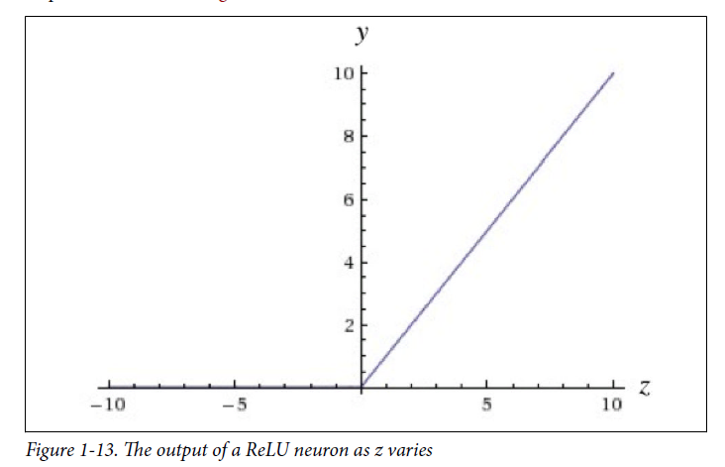
RELU

Slide 18
Softmax function
The softmax function can be used for multiclass classification problems.
Softmax function is often described as a combination of multiple sigmoids.
sigmoid returns values between 0 and 1, which can be treated as probabilities of a data point belonging to a particular class.
Thus sigmoid is widely used for binary classification problems.

Slide 19
softmax
This function returns the probability for a data point belonging to each individual class.
Oftentimes, we want our output vector to be a probability distribution over a set of mutually exclusive labels. For example, let’s say we want to build a neural network to recognize handwritten digits from the MNIST dataset.
Each label (0 through 9) is mutually exclusive, but it’s unlikely that we will be able to recognize digits with 100% confidence.
Using a probability distribution gives us a better idea of how confident we are in our predictions.

Slide 20


As a result, the desired output vector is of the form below,
This is achieved by using a special output layer called a softmax layer.
Unlike in other kinds of layers, the output of a neuron in a softmax layer depends on the outputs of all the other neurons in its layer. This is because we require the sum of all the outputs to be equal to 1.
Letting zi be the logit of the ith softmax function, we can achieve this normalization by setting its output to:
y_{i}=

Slide 21
strong prediction would have a single entry in the vector close to 1, while the remaining entries were close to 0.
A weak prediction would have multiple possible labels that are more or less equally likely.

Slide 22
Important: Refer the following links
https://www.analyticsvidhya.com/blog/2020/01/fundamentals-deep-learning-activation-functions-when-to-use-them/
---You can have the draw backs and
implementations of each activation function
https://towardsdatascience.com/activation-functions-neural-networks-1cbd9f8d91d6
----See formulas and shapes

